Slide 1
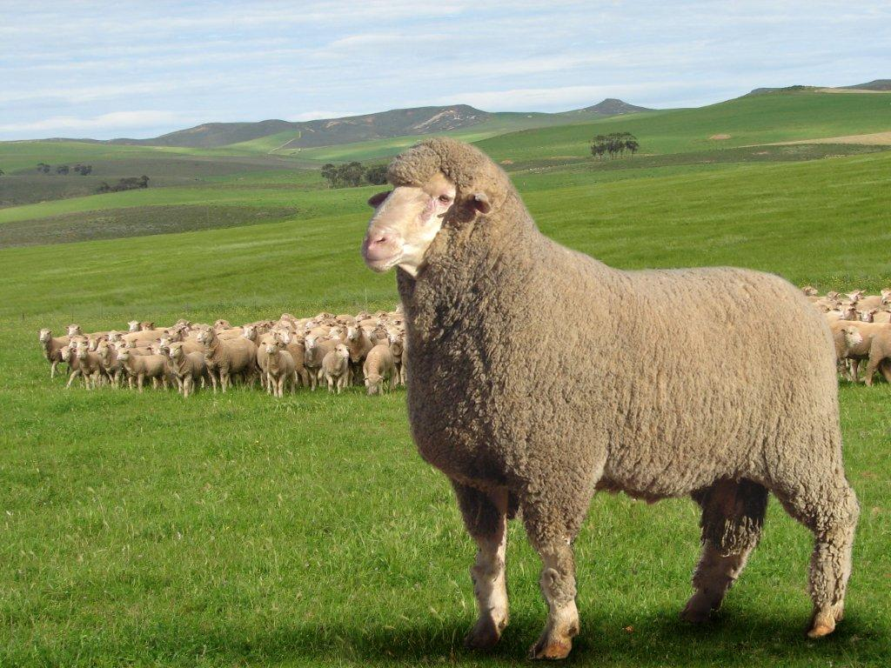
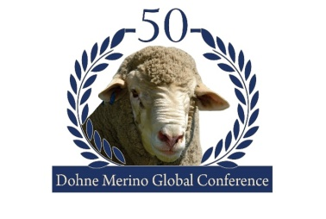
CELEBRATING 50 YEARS 1966 -2016
Commit to the Lord whatever you do
and your plans will succeed. Proverbs 16.3

Slide 2
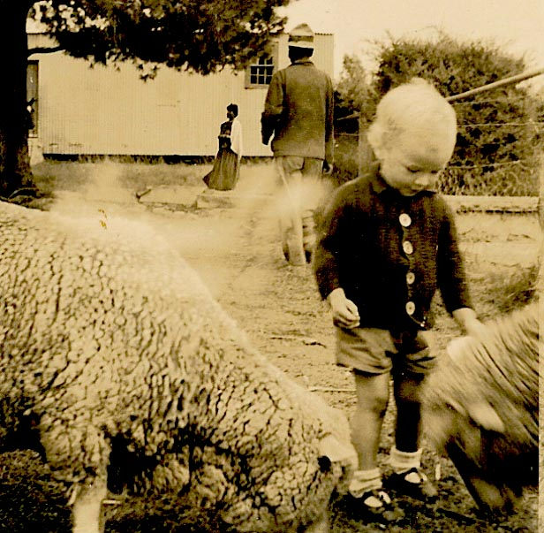
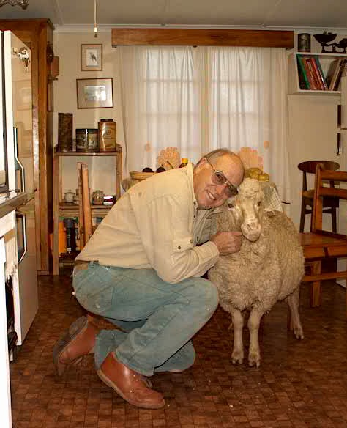
CELEBRATING 50 YEARS 1966 -2016
My relationship with sheep began at an early age and has persisted throughout my life
Becoming more intimate as my career progressed

Slide 3
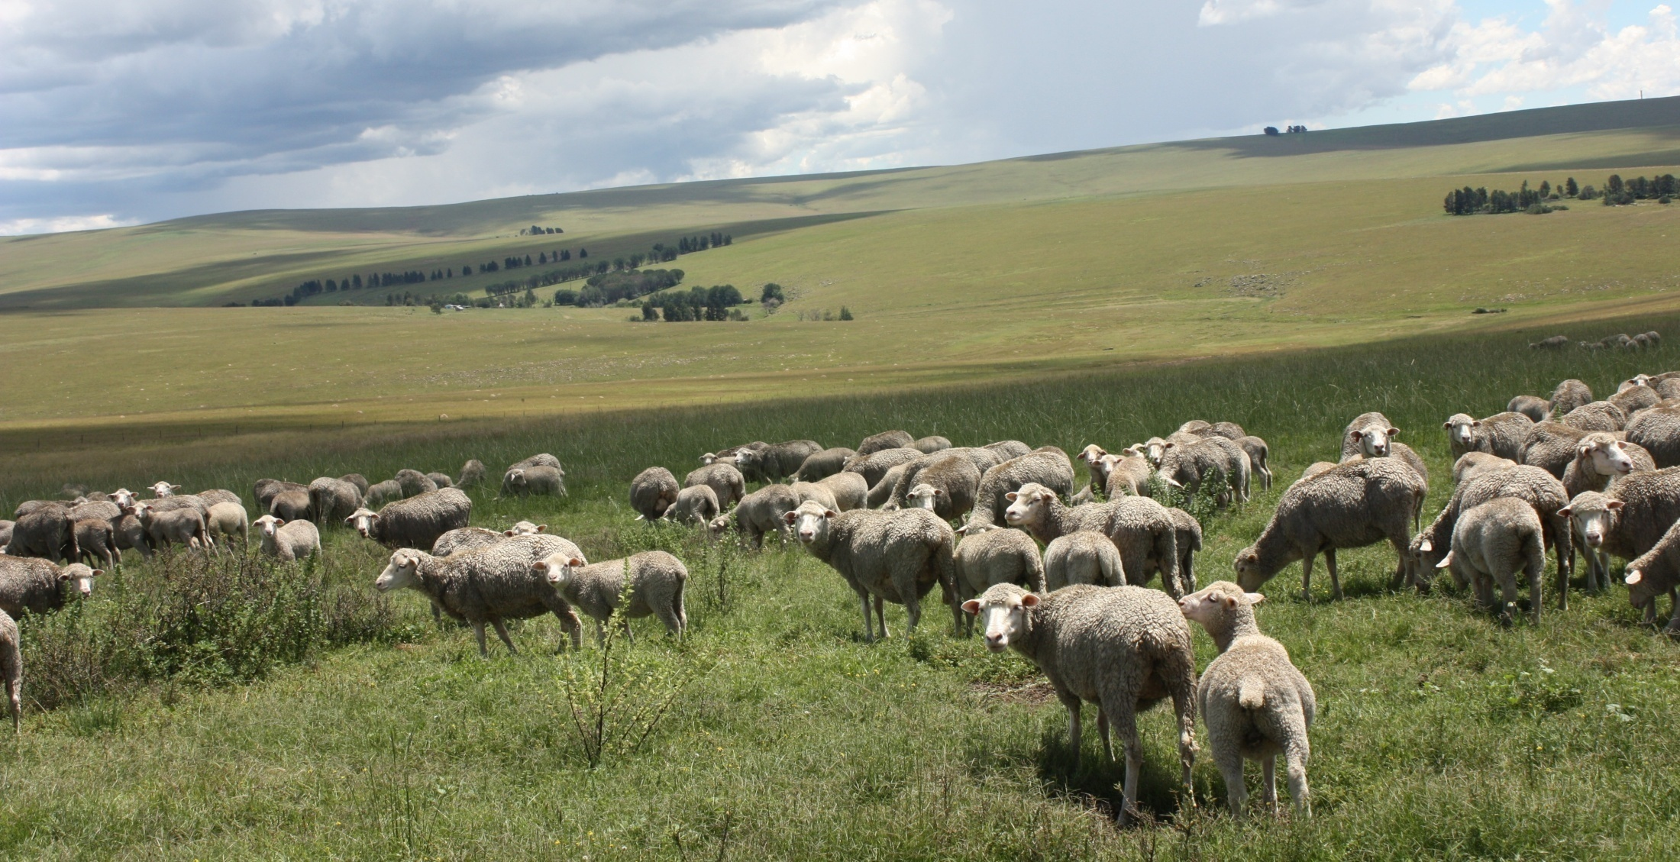
CELEBRATING 50 YEARS 1966 -2016
BEGINNINGS
1937 Dohne Research Station established
A better adapted sheep type for the East Cape sourveld set as one of its goals
Initial trials commenced in 1939 - Mr JJJ Kotze

Slide 4
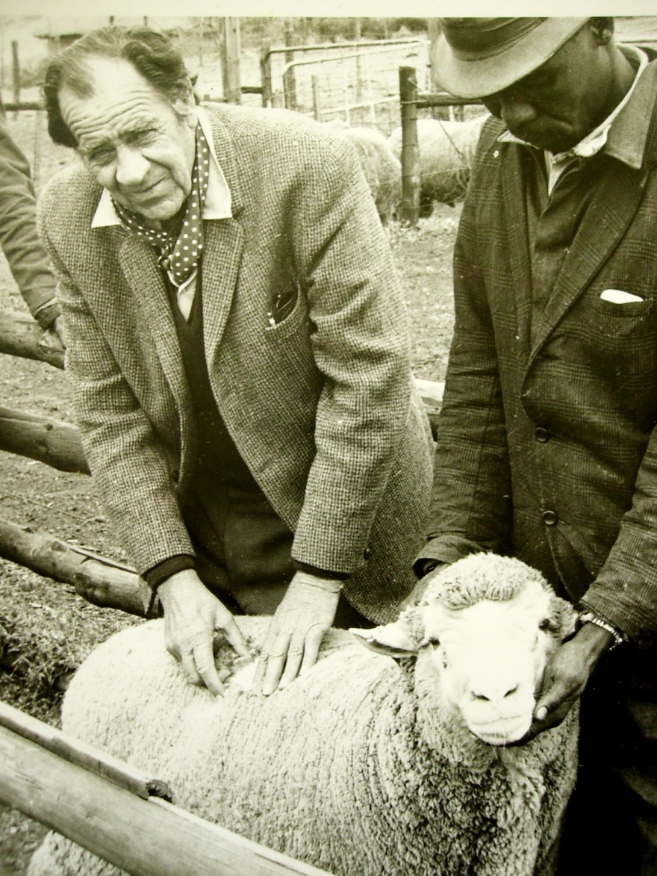
CELEBRATING 50 YEARS 1966 -2016
Mr JJJ (Koot Kotzé) Father of the Dohne
1939 German Mutton Merino x Merino. The excellent characteristics of the first cross fixed, through inter-breeding and selection.
Parameters:
Pedigrees and performance recorded.
Sheep to be run under identical conditions in a natural commercial environment.
He defined the selection procedures that are followed to this day.
Very advanced requirements at this time (the early and mid 1940s)
By observing the most productive and best adapted sheep in each generation, Koot Kotzé himself defined the ideal breed type.

Slide 5
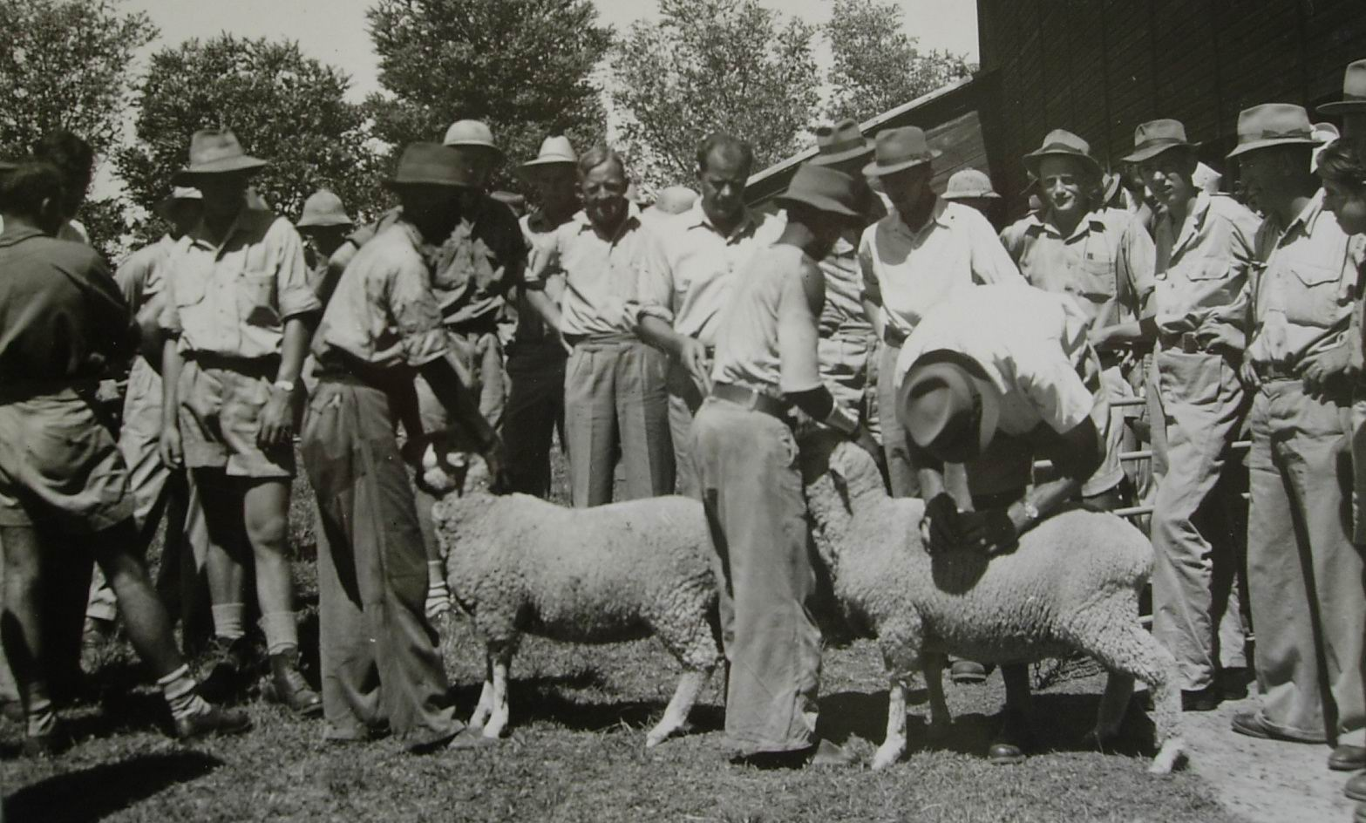
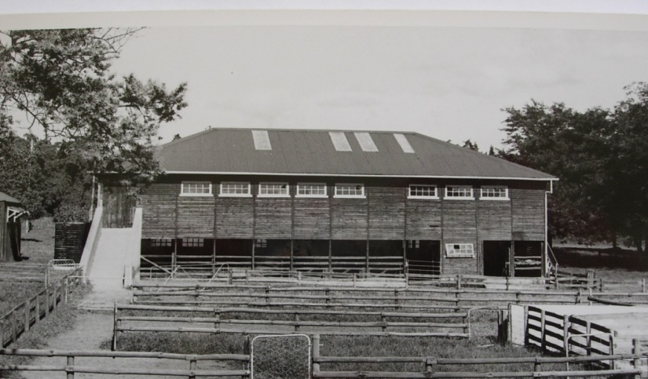
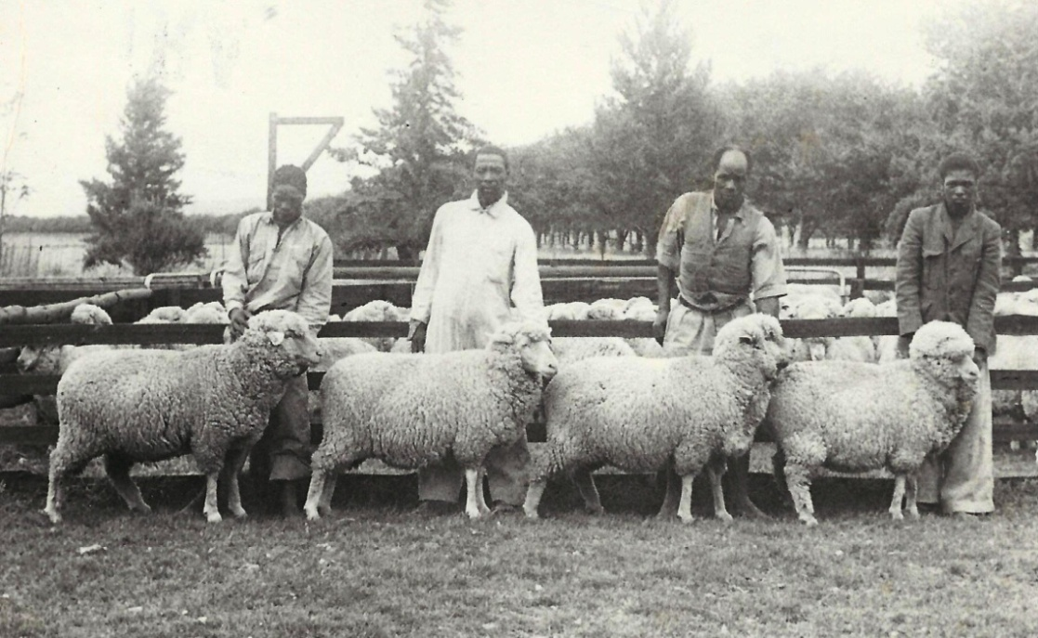
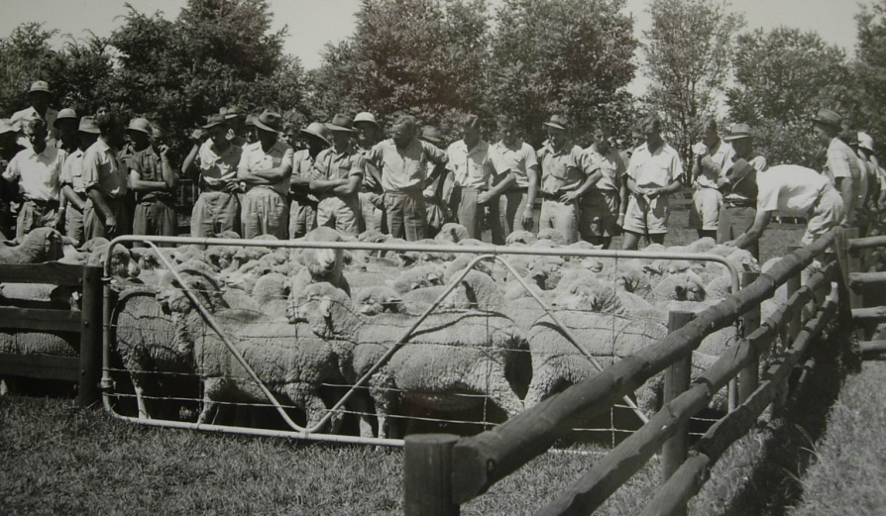
CELEBRATING 50 YEARS 1966 -2016
Original wool shed and yards
Field Day 1949
F3 F2 F1 Merino

Slide 6
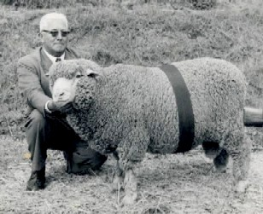
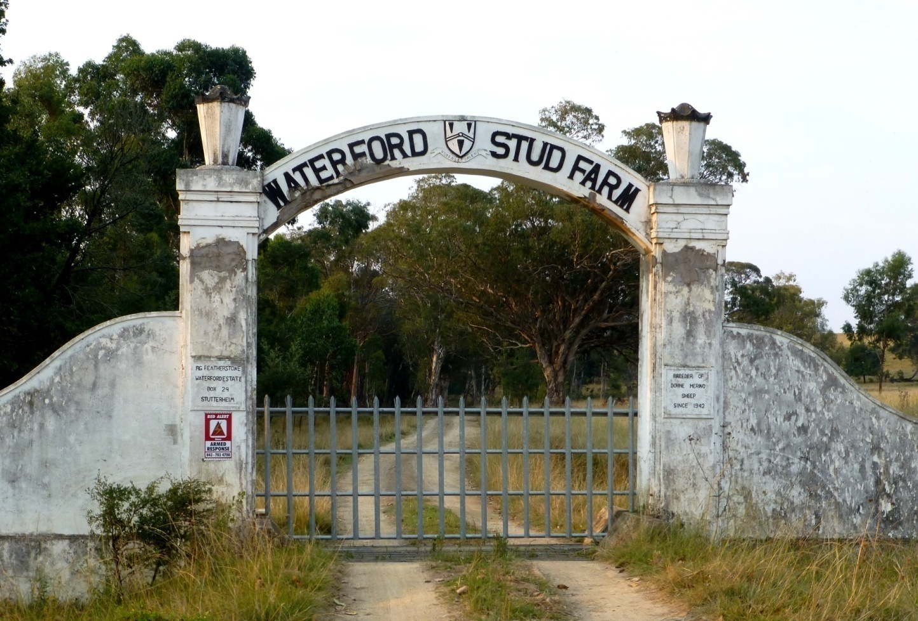
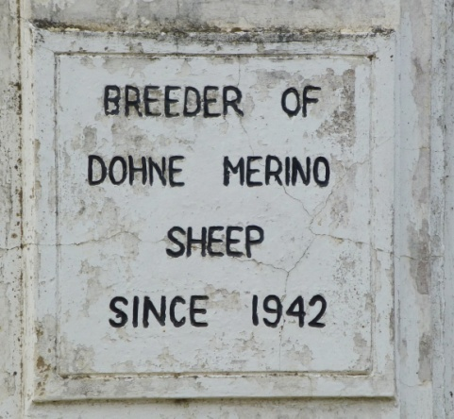
CELEBRATING 50 YEARS 1966 -2016
First Foundation Stud - 1942
Gerald Featherston – Waterford Estate

Slide 7
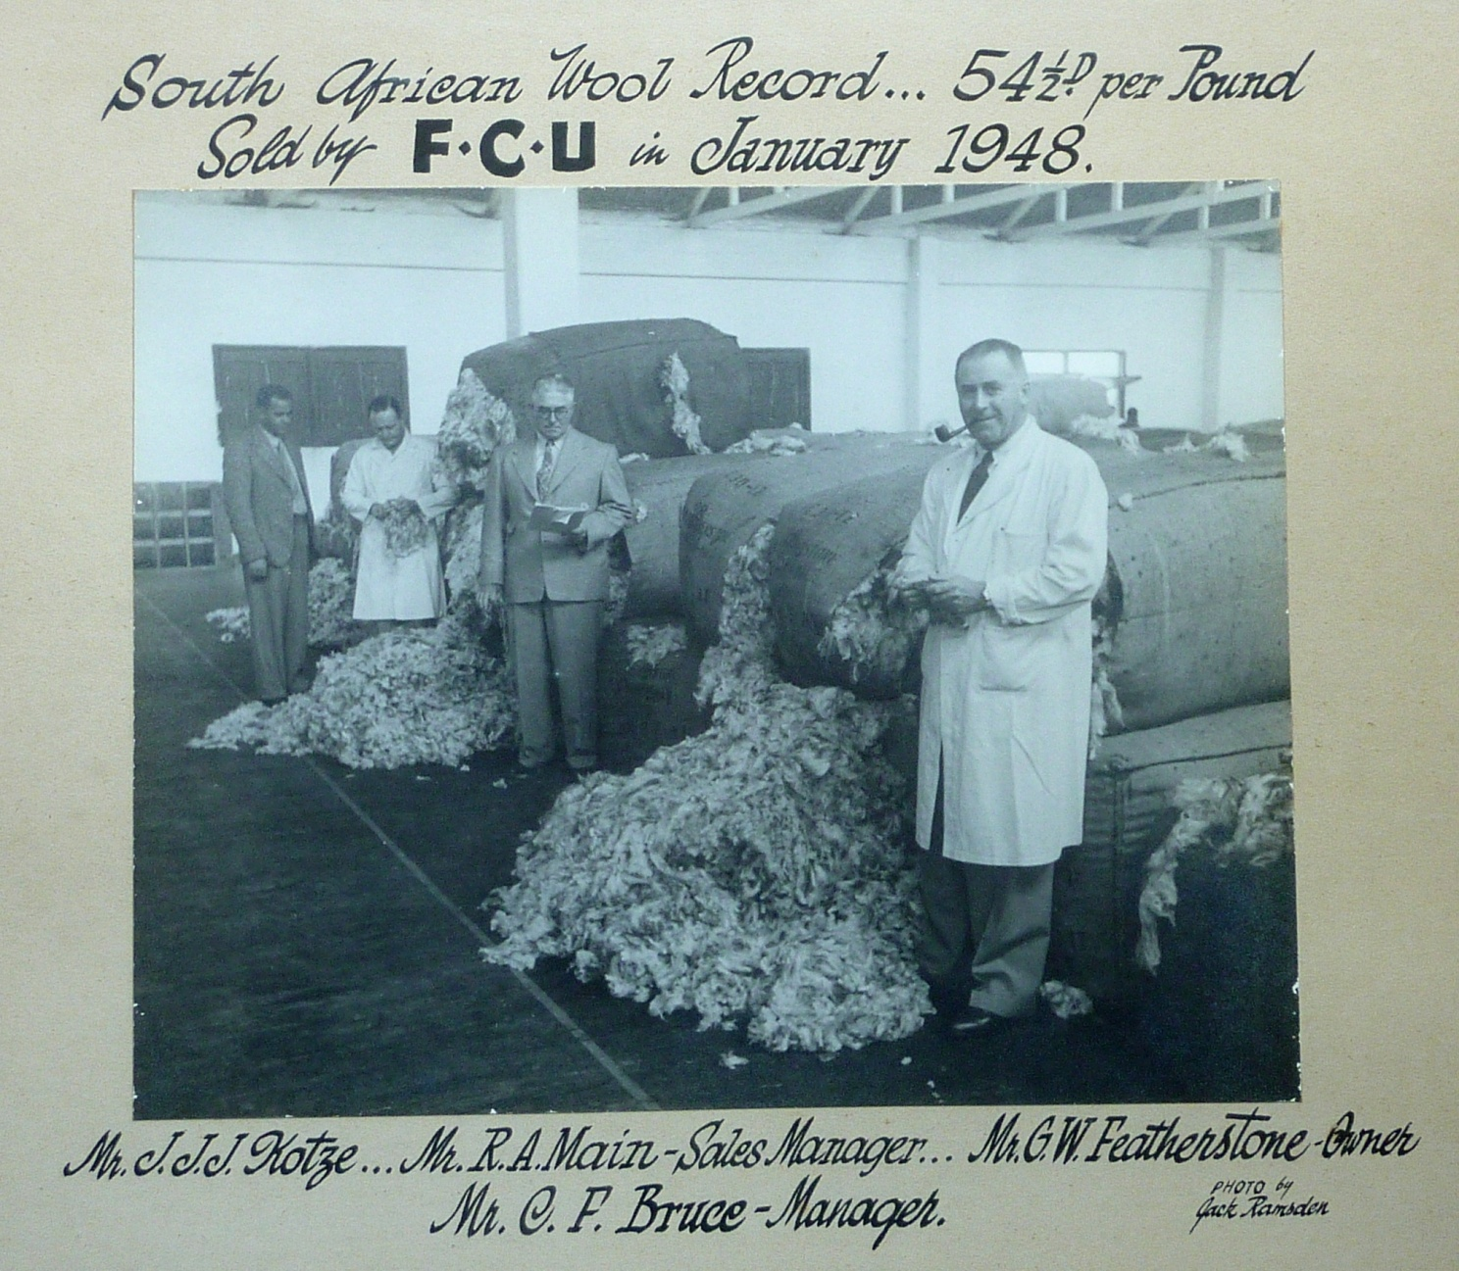
CELEBRATING 50 YEARS 1966 -2016
SA record wool price
Waterford Estate
wool sale - 1948

Slide 8
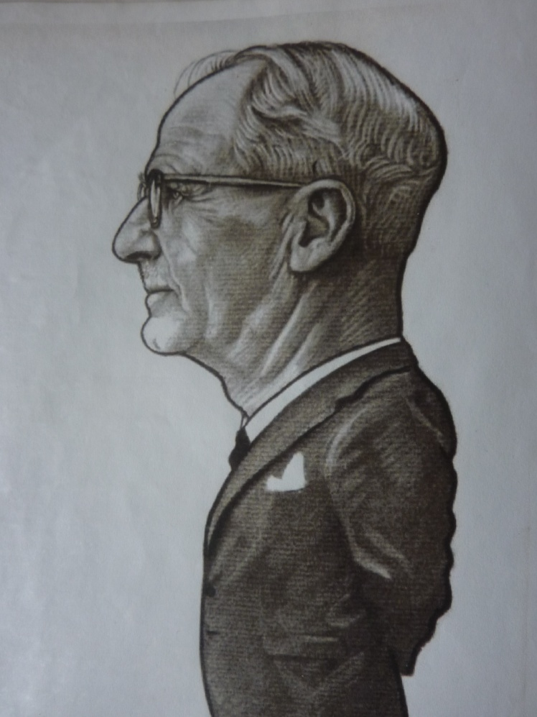
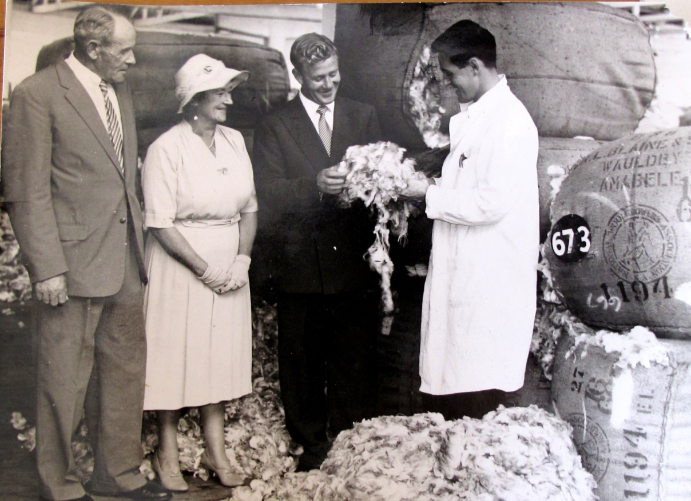
CELEBRATING 50 YEARS 1966 -2016
Early collaborators - 1947
Jack Blaine – Ross Stud
Deemie Blaine, Wauldy Stud

Slide 9
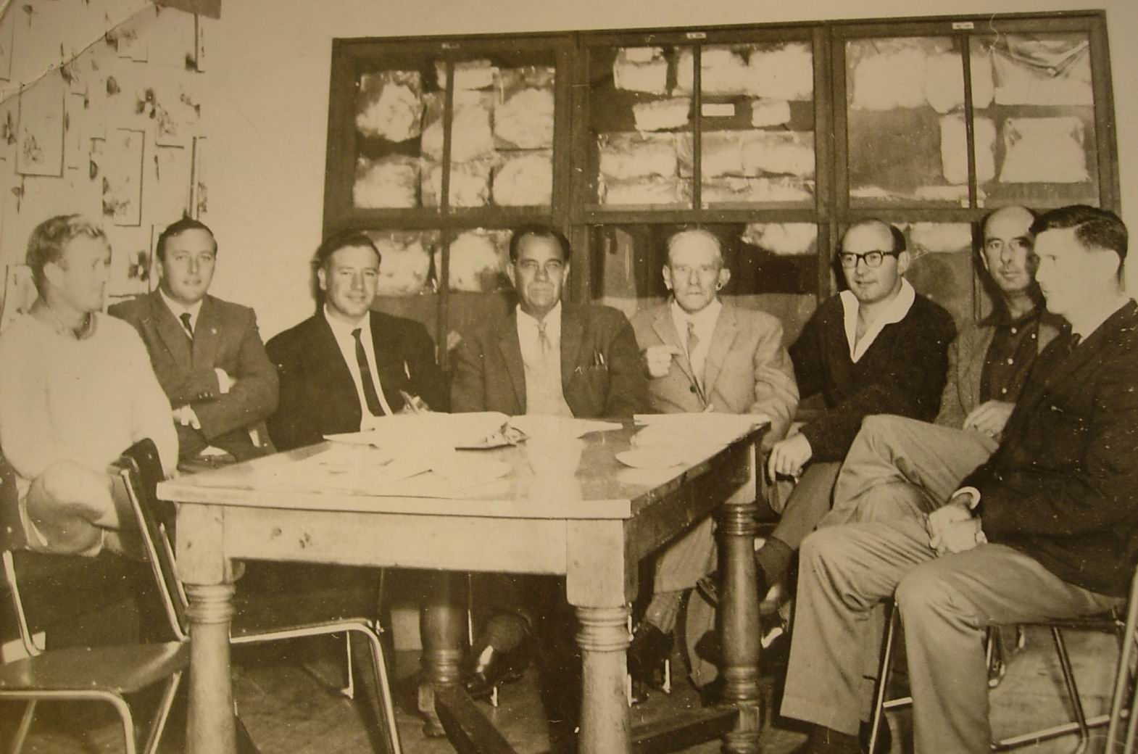
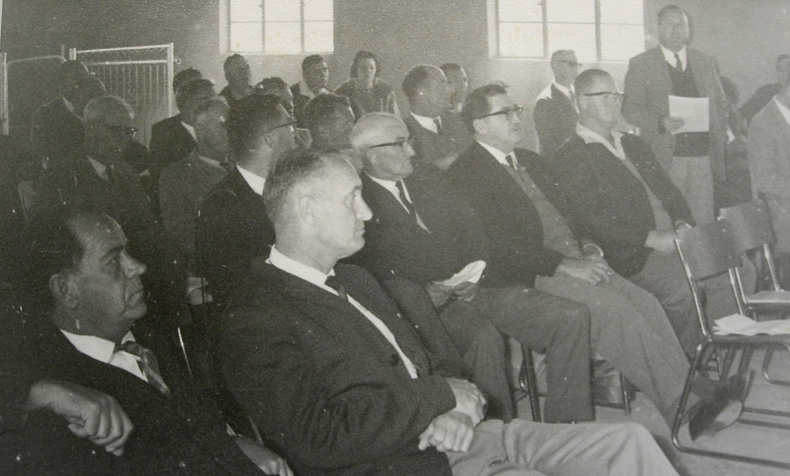
CELEBRATING 50 YEARS 1966 -2016
Feb 1966
Steering committee to form a Society
Inaugural meeting
16 May 1966
The only picture I have of the meeting:
Koot Kotze lower left;
next to him
Dr Wim Verbeeck, National Director of Animal Husbandry who was guest of honour

Slide 10
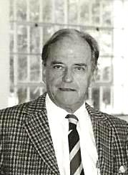
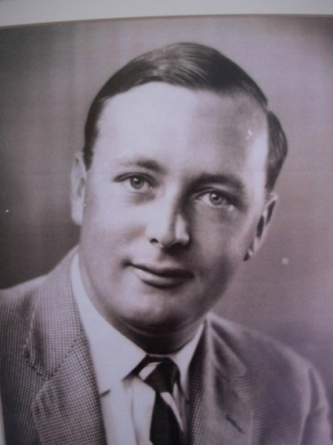
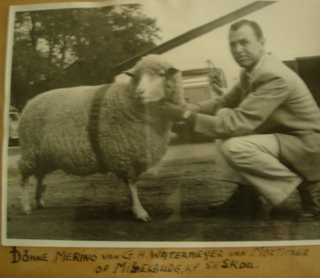
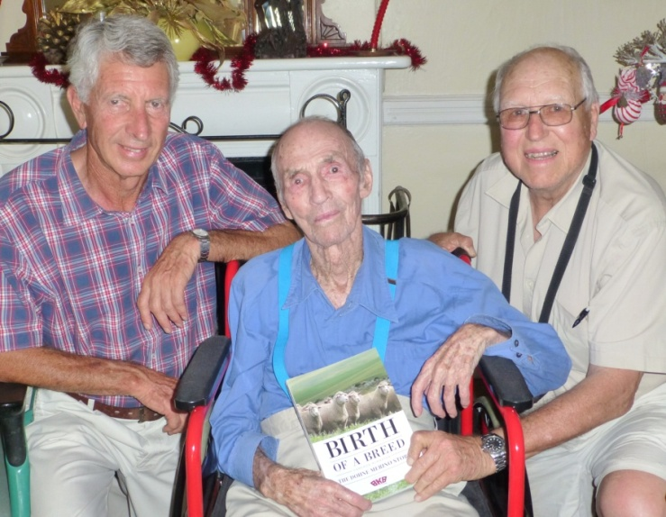
CELEBRATING 50 YEARS 1966 -2016
R O le Roux of the Dirko Stud was elected first President and Noel Geach, manager of the Waterford Stud, first Secretary
I believe only three persons who were at the inaugural meeting in May 1966 are still alive today.
Pinky Watermeyer was elected to the first Council. Lionel de la Harpe and I visited him in Dec 2015 and presented a copy of the book to him.

Slide 11
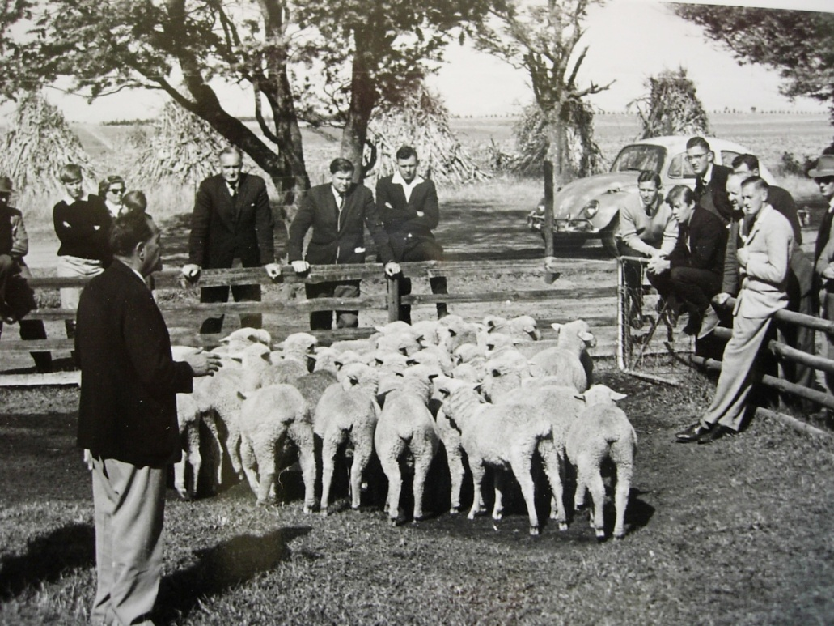
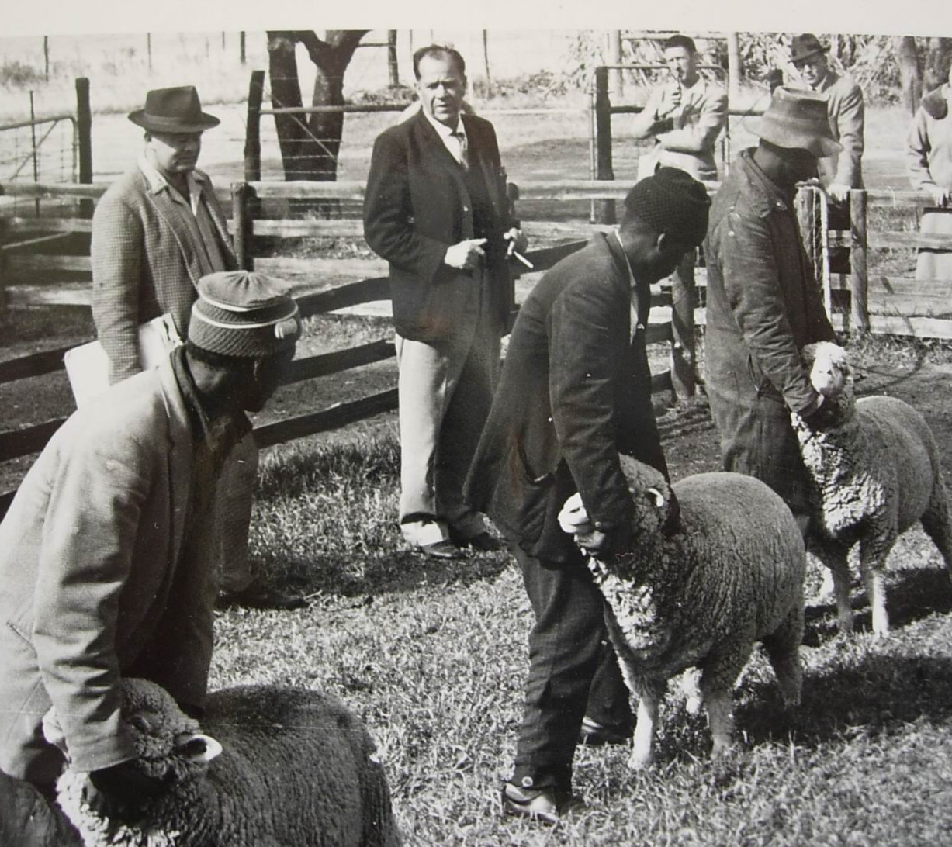
CELEBRATING 50 YEARS 1966 -2016
Field Day in conjunction with the inaugural meeting - May 1966
Mr Kotzé demonstrating at the Field Day

Slide 12
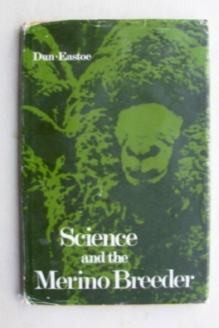
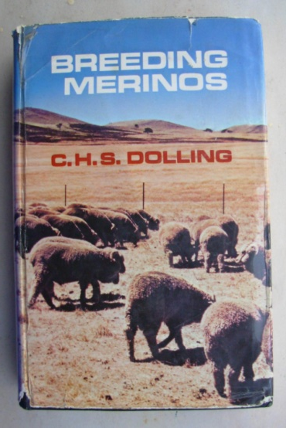
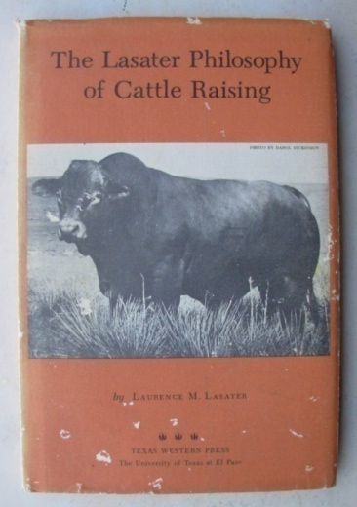
CELEBRATING 50 YEARS 1966 -2016
A NEW PARADIGM
Already committed to a new venture, unencumbered by the constraints of tradition and being innovators by nature, pioneer Dohne breeders easily embraced the new concepts and principles being advocated at the time.
There was a wealth of new information :
"Science and the Merino Breeder"
by Dun and Easto, 1970
"Breeding Merinos" by Scott Dolling, 1970
We even borrowed heavily from the logical and
practical principles set out in the
"Lasater Philosopy of Cattle Raising".
His statement Females are the basic business of livestock breeding
struck a chord with us. Selecting rams that were the progeny of highly productive and fertile ewes became standard practice.

Slide 13
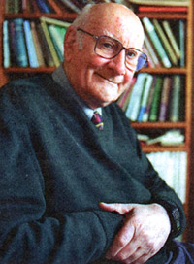
CELEBRATING 50 YEARS 1966 -2016
Innovative breeding systems
When innovators in Australia and New Zealand introduced the system of Open Nucleus Breeding, we enthusiastically followed suit.
After failing to make progress in a small closed stud, Tony Parker of the Romney Development Group, on the advice of Prof Al Rae of Massey University, began to introduce high performing females from his clients flocks, thus "opening" his stud to ewes of proven performance.
I visited Tony Parker and Prof Rae in 1974. The most valuable lesson we learned from Tony was to enlist Nature as a partner and observe the shape and type of animal that would evolve through selection on performance.
No longer were replacement sheep required to conform to the outdated breed standards dictated by the show ring.

Slide 14
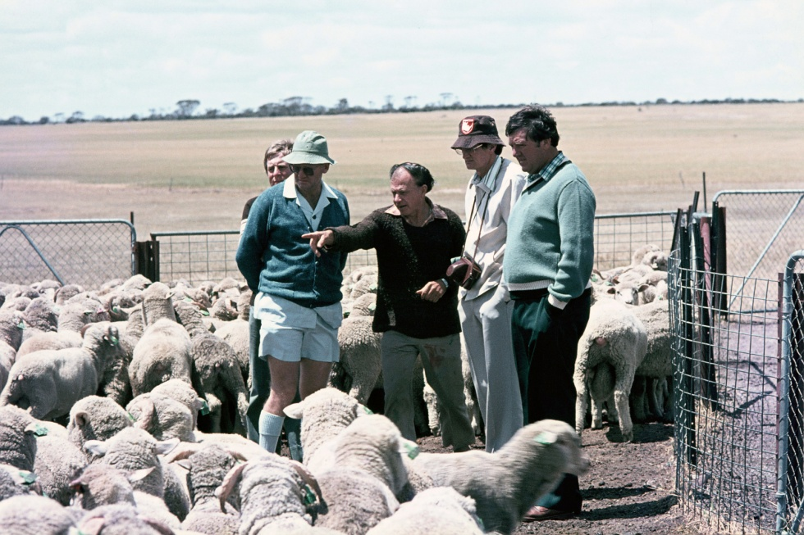
CELEBRATING 50 YEARS 1966 -2016
Another important mentor was Jim Shepherd of the Australian Merino Society in WA.
He believed that outstanding breeding
material was also present in daughter
studs and commercial flocks and should be
utilized.
He stated that it was tantamount to
a national sin not to identify high
performing females in commercial
flocks and use them in ram breeding
programmes.
This led to his de-registration “for conduct contrary to the objects and ethics of the Australian Stud Merino Breeders’ Association”. It was very strange that the Stud Breeders at the time considered this serious attempt to improve the productivity and adaptability of Merino sheep as a malpractice.

Slide 15
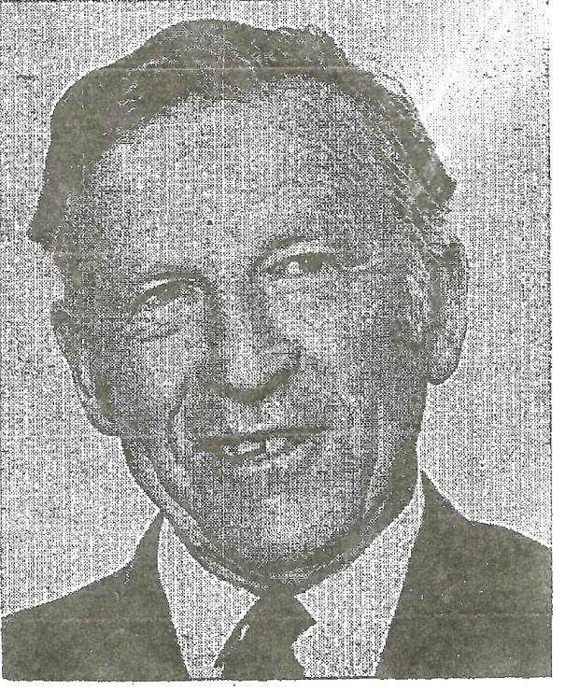
CELEBRATING 50 YEARS 1966 -2016
The Foundation Flock Register
The concept of the Open Nucleus System was so logical and practical and offered so much promise that it was extended to the Foundation Flock Register, where provision was made for promoting females from commercial flocks.
We followed the principle of promoting only ewes in the top 20% of a measured age group at the F3 generation. This was a principle adopted by Prof Ian Coop of Lincoln University in the development of the Coopworth, a synthetic breed developed along the same lines as the Dohne with strict emphasis on performance.
I was privileged to visit Prof Coop in 1974
Over the decades that this principle has been
applied in South Africa, it has had a profoundly positive result.

Slide 16
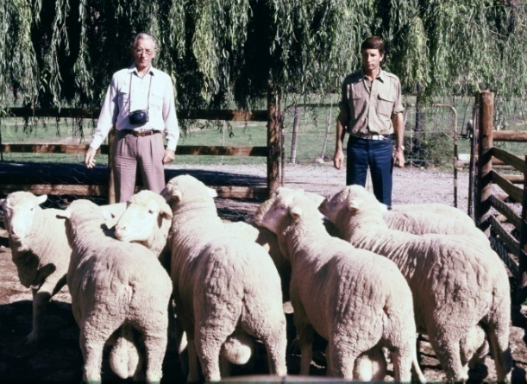
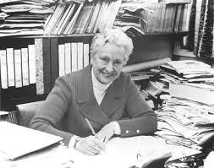
CELEBRATING 50 YEARS 1966 -2016
Rearing rams in commercial paddock conditions
Another innovator with whom we maintained close links was Jim Maple Brown of Goulburne NSW. Under the guidance of Dr Helen Newton Turner, he pioneered the use of selection indices. He was probably the first ram breeder ever to use the (now primitive) computers of the time - 1974 - to store and process sheep records.
He believed in rearing rams in large mobs under commercial paddock conditions in order to ensure equitable comparisons between individuals and to identify those best adapted to the commercial environment.
This fundamental principle still forms the basis of our philosophy.
Jim Maple Bown, left
Dr Helen Newton Turner

Slide 17
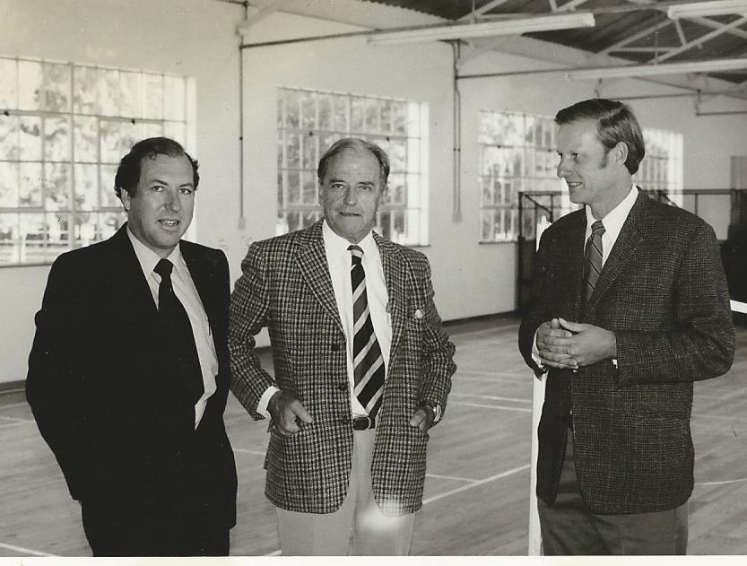
CELEBRATING 50 YEARS 1966 -2016
1976 – The 10th Anniversary
At the end of the first year 36 small studs were registered with
2500 registered ewes
At the end of 1979 there were 103 registered studs with
18,543 recorded ewes
At the 10th AGM in 1976, Roelie le Roux resigned after 10 very effective years as president.
John Torr was the next president. He served with distinction for 15 years.

Slide 18
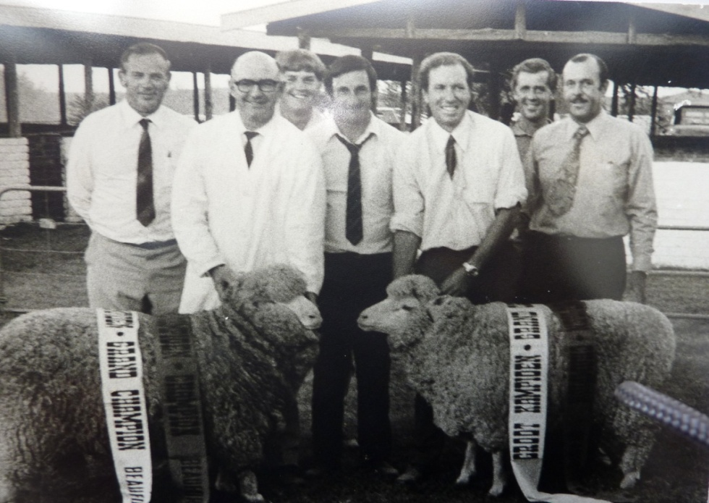
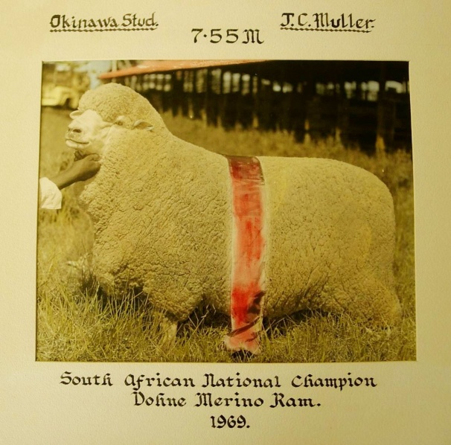
CELEBRATING 50 YEARS 1966 -2016
Competitive Shows scrapped in 1978
The success of a stud was now determined by its performance in a commercial environment - not by performance in the show ring.
All animals were now evaluated according to their measured relative efficiency in a commercial environment. Breeders were reluctant to isolate sheep for show preparation.
Show success was no longer of any use to breeders or their clients.
X
X
1973

Slide 19
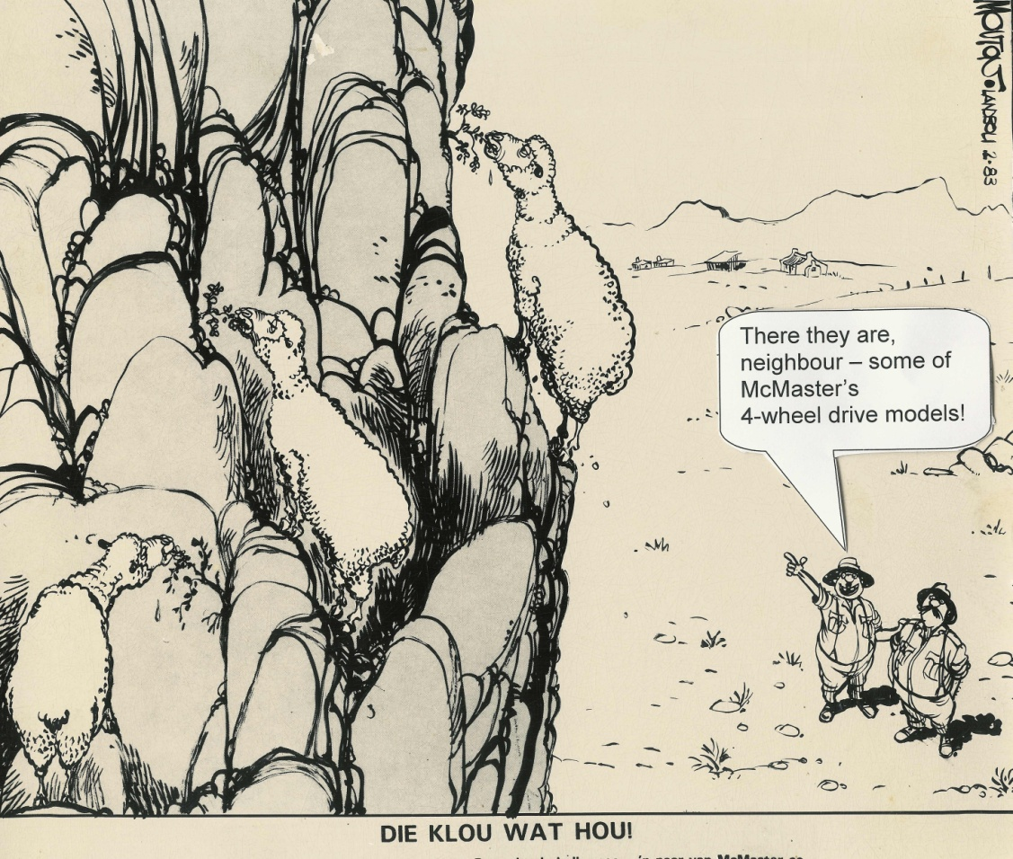
CELEBRATING 50 YEARS 1966 -2016
Exceptional growth over the first three decades
By 1990 there were over 300 breeders with nearly 48,000 recorded ewes, spread over the entire country.
This was the result of:
Rapid improvement due to effective
breeding and selection methods
The superior productivity of the Dohne (the 4-wheel drive sheep!)
An education programme targeted
at stud breeders, assessors and flock breeders
Effective publicity and promotion

Slide 20
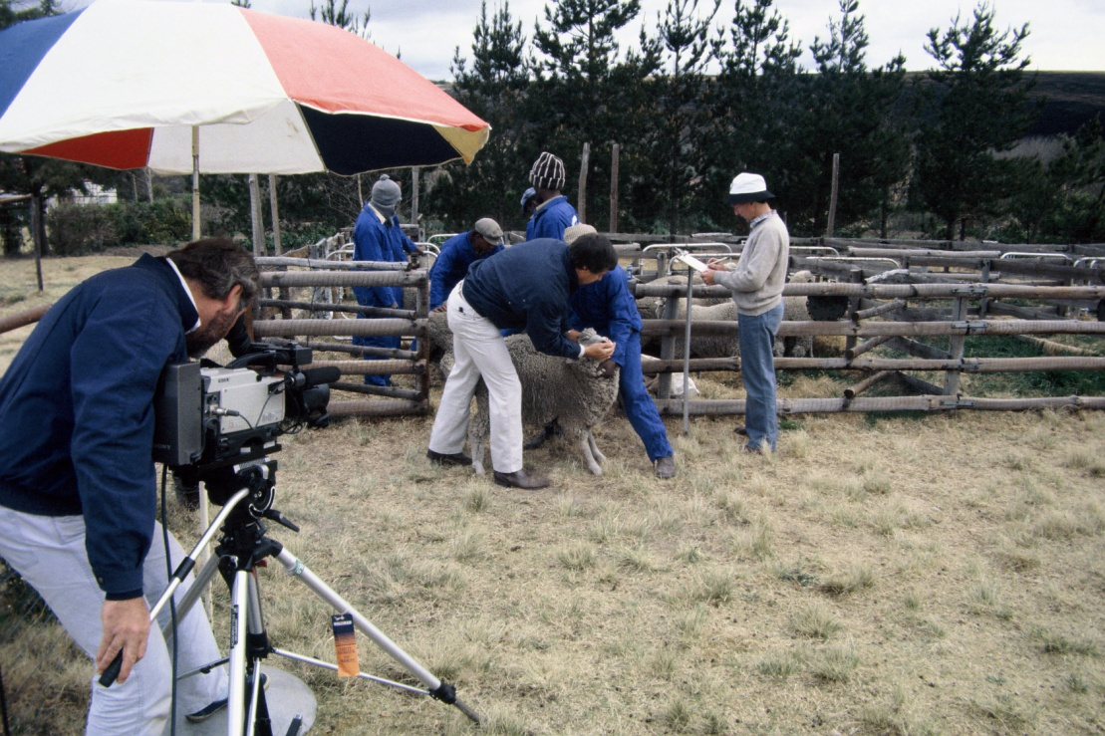
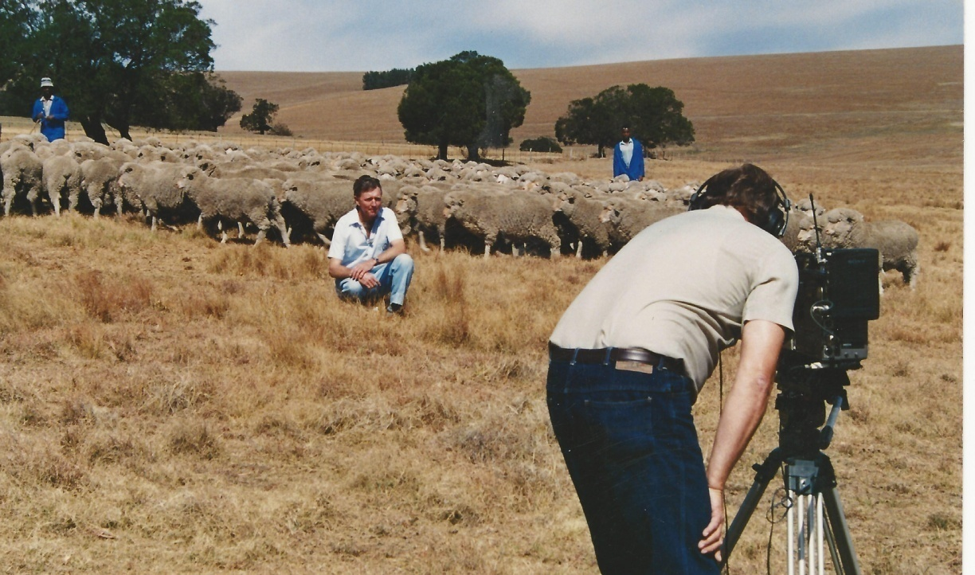
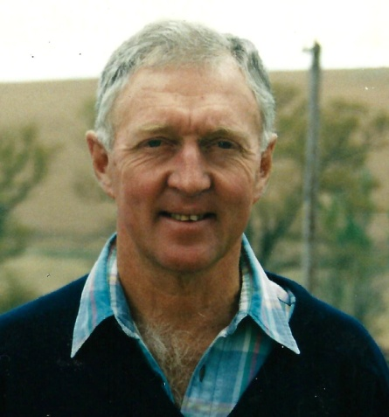
CELEBRATING 50 YEARS 1966 -2016
1989 - Our first Video – later converted to DVD
Produced with the assistance of Stellenbosch University
These images taken at the Eastern Dohne Central Nucleus
Barry Armstrong of the EDCN made an enormous contribution to the development of the Dohne. He was my lifelong friend.

Slide 21
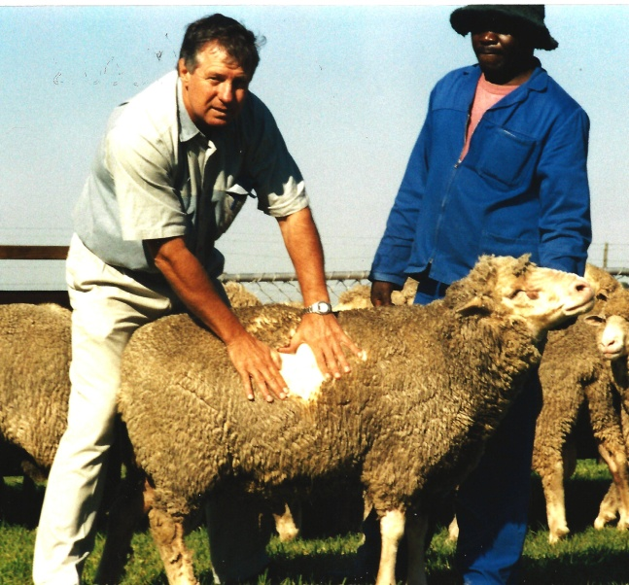
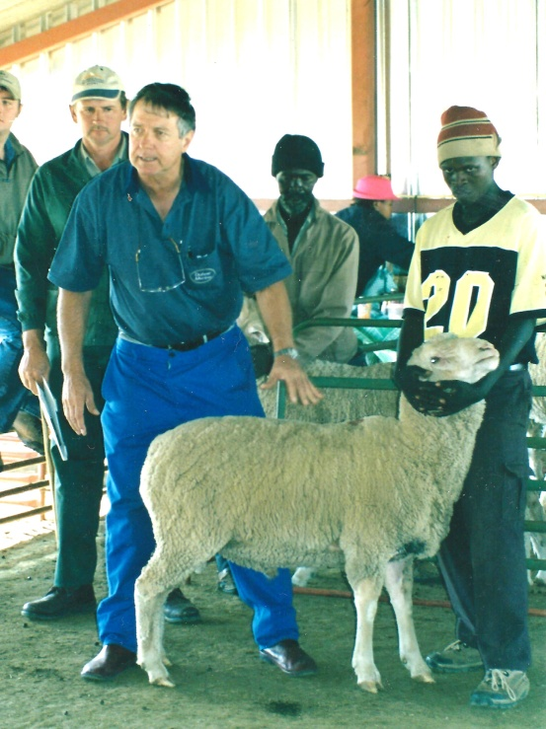
CELEBRATING 50 YEARS 1966 -2016
1988 – Henri Londt joined the staff of the Society
Henri Londt joined the staff of the society in 1988 initiating a new era of progress.
He was energetic, enthusiastic and ambitious, but above all highly capable and passionate about performance recording and scientific selection.
For the next 24 years he became
the face of the Dohne Merino,
taking it to ever greater heights
and extending its boundaries to
all sheep countries of the
southern hemisphere
Henri -
the sheepman
Henri -
the teacher

Slide 22
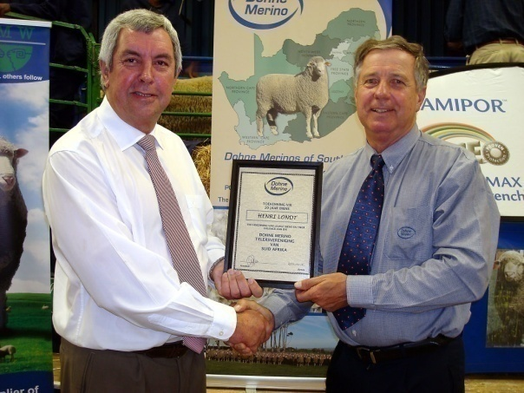
CELEBRATING 50 YEARS 1966 -2016
1994 - Sire reference schemes reveal the flaws in our system
Henri visited Australia and New Zealand in 1991.
Sire reference schemes (SRS) were largely replacing nucleus
flocks as an instrument for breed improvement in New Zealand.
Having been thoroughly briefed by Professor Al Rae
of Massey University, Henri established a number of SRSs.
Using the new technology of breeding value determination, Henri was able to accurately assess the direction in which the breed was heading.
This lead to the remarkable realisation that too much emphasis on fleece weight was inhibiting progress in terms of reproduction and growth rate, the major components of flock income.

Slide 23
CELEBRATING 50 YEARS 1966 -2016
Henri’s classical analysis of sires in the SRSs
Henri discovered that 93% of our 30 top sires were breeding excessive fleece weight . We had begun to deviate from the principle of true dual-purpose sheep.
Figure:
Henri Londt
From the 1990s wool was no longer the main income driver – it was meat. The key to increasing profitability was not fleece weight but rather the correct relationship between fleece weight and body weight – defined as Wool Production Potential.
WPP% = Clean fleece weight expressed as a percentage of body weight at test age

Slide 24
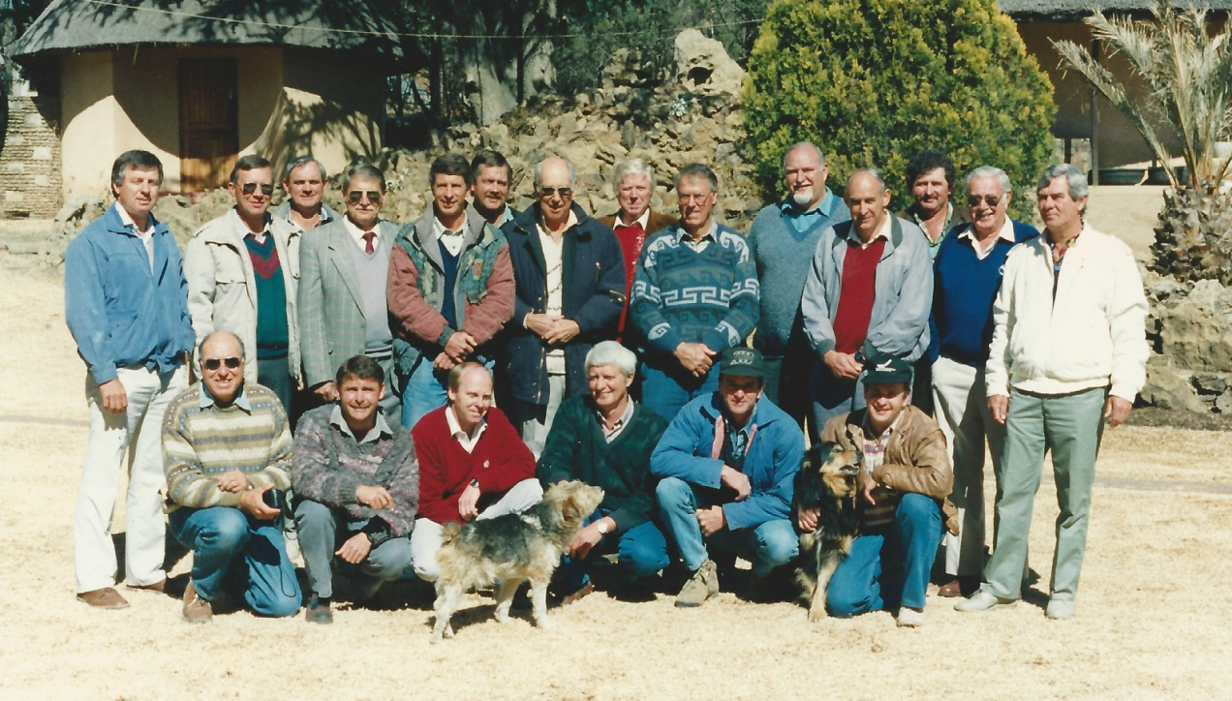
CELEBRATING 50 YEARS 1966 -2016
Targeted research by Wentzel (1991) Herselman et al (1993) revealed that excessively high fleece weight, relative to body weight, is negatively correlated with the traits that promote meat production – hardiness, reproduction rate and growth rate
Our sheep were probably already genetically capable of growing more wool than the environment could sustain, and this was impeding their potential for meat production.
At a workshop in 1995 we amended the selection index, reducing the fleece weight component and increasing the emphasis on fibre diameter.
The WPP% and fibre diameter declined, the fitness of our sheep improved dramatically as did lambing percentages and growth rate.

Slide 25
CELEBRATING 50 YEARS 1966 -2016
In 1996 the average WPP% of all Dohnes was 6.76%; the average lambing was 108%. Thirteen years later in 2009 the WPP% was 5.15% and lambing over all studs had risen to 141%!
While a proportion of the improved reproduction must be attributed to better management, there is nevertheless a strong relationship between reproduction and WPP%

Slide 26
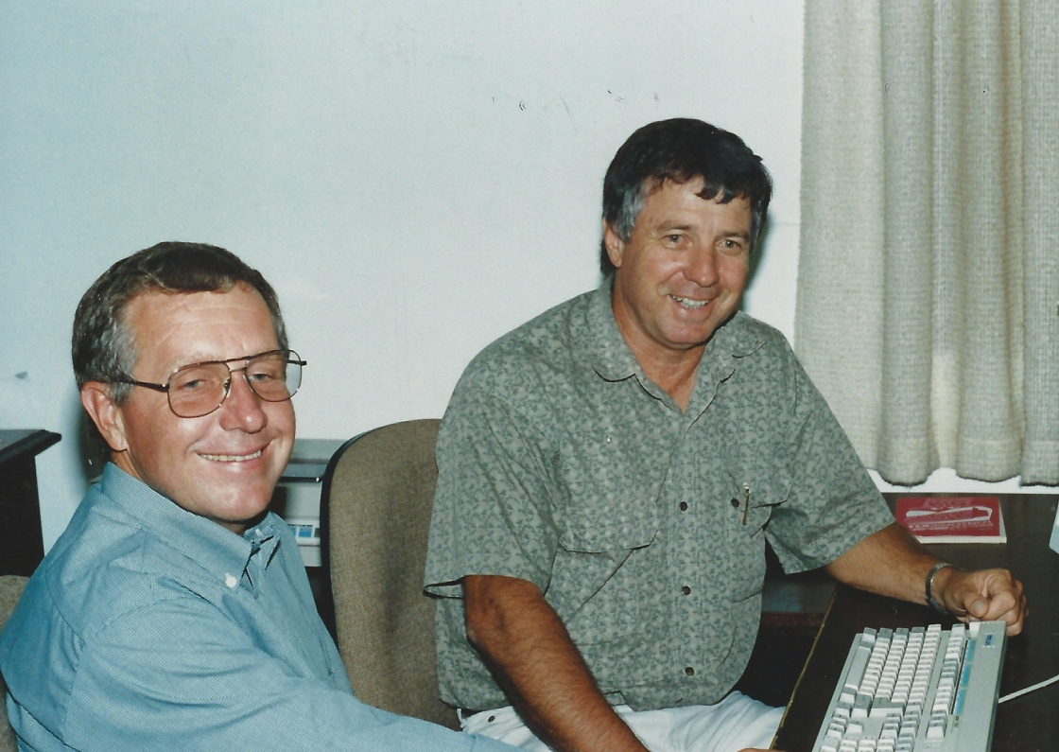
CELEBRATING 50 YEARS 1966 -2016
The transition to across flock breeding values
In addition to fine-tuning the selection indices, with the help and guidance of Dr Kobus Delport and Dr Buks Olivier, Henri managed the transition to across flock breeding values, bringing the Society fully in line with international best practice.
It is impossible to quantify the
enormous contribution that
Henri made to the development of
the Dohne Breed worldwide.
It is a tragedy that he was taken
from us in 2012 at the height of his
career.
Dr Kobus Delport succeeded him
as Breed Director

Slide 27
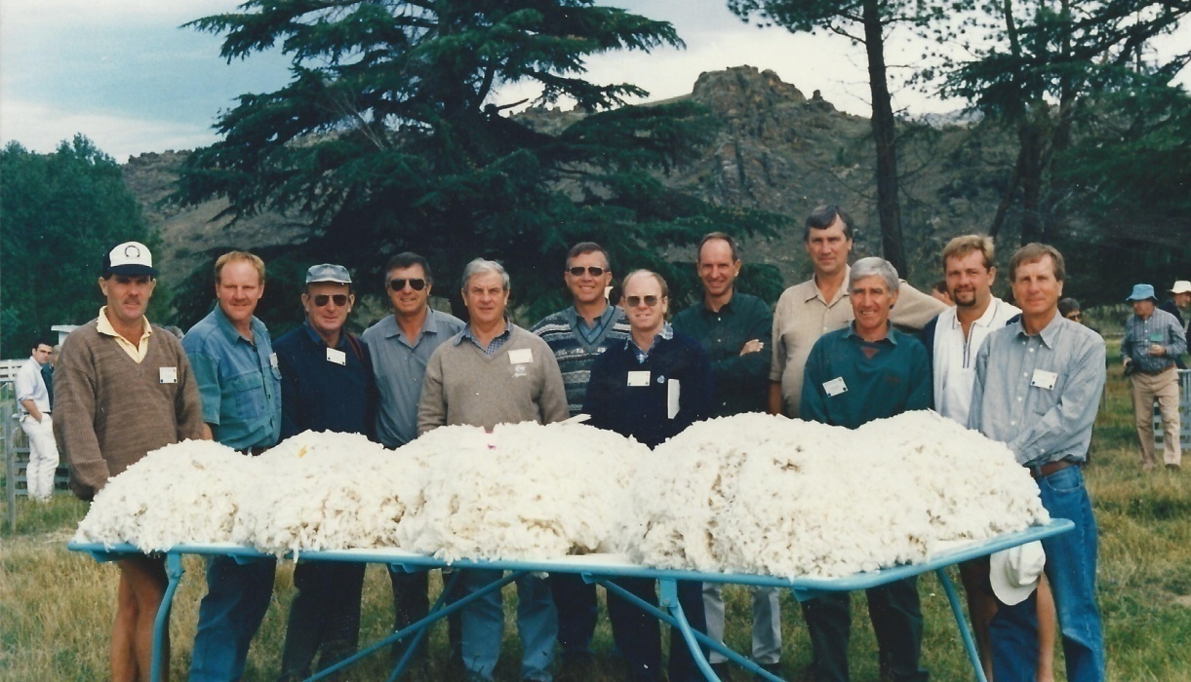
CELEBRATING 50 YEARS 1966 -2016
International outreach
Effective international promotion done at successive Merino Conferences and other international events
Sheep and Beef Cattle Conference, New Zealand 1980, and Pretoria 1984
3rd World Merino Conference, Pretoria – 1991
4th World Merino Conference,
Uruguay– 1994
World Sheep and Wool
Conference, Malvern, UK – 1995
5th World Merino Conference,
Christchurch NZ – 1998 (right)

Slide 28
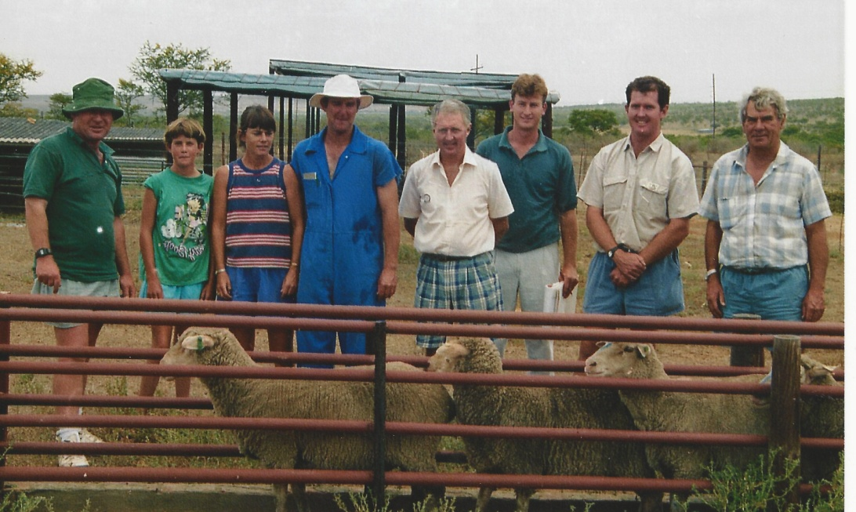
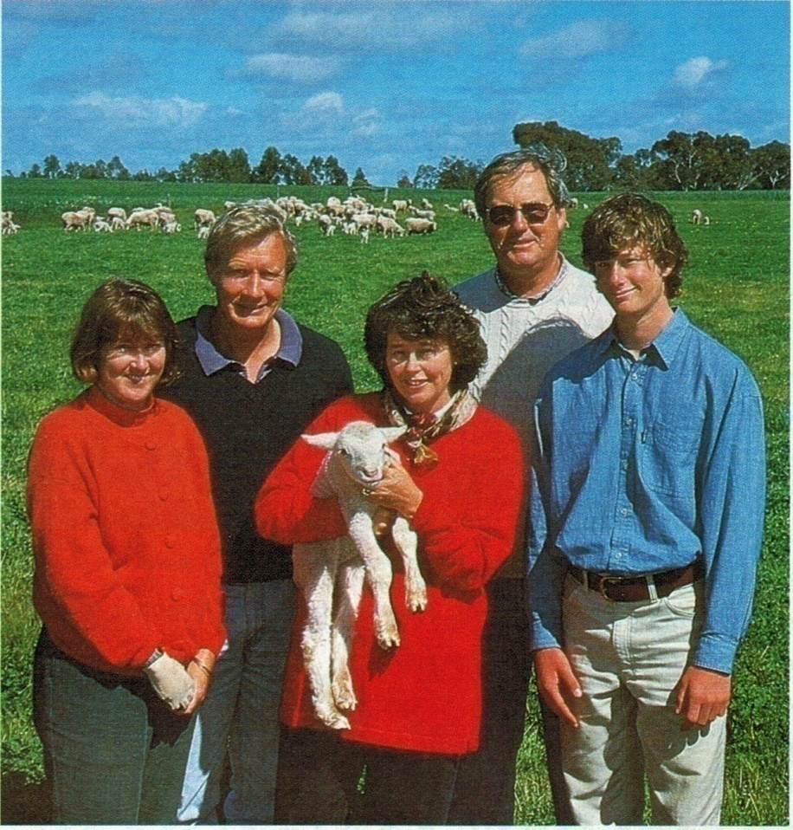
CELEBRATING 50 YEARS 1966 -2016
1998 – first embryos to Australia
Members of the EDCN deliver first donor ewes to Dr Jean van Niekerk, Bedford
First lamb born in Australia, October 1998
Lyn and Alex Leach, Helen and Geoff Beeck, with Cameron Beeck, formed the first two studs – Glenlea and Summerfield

Slide 29
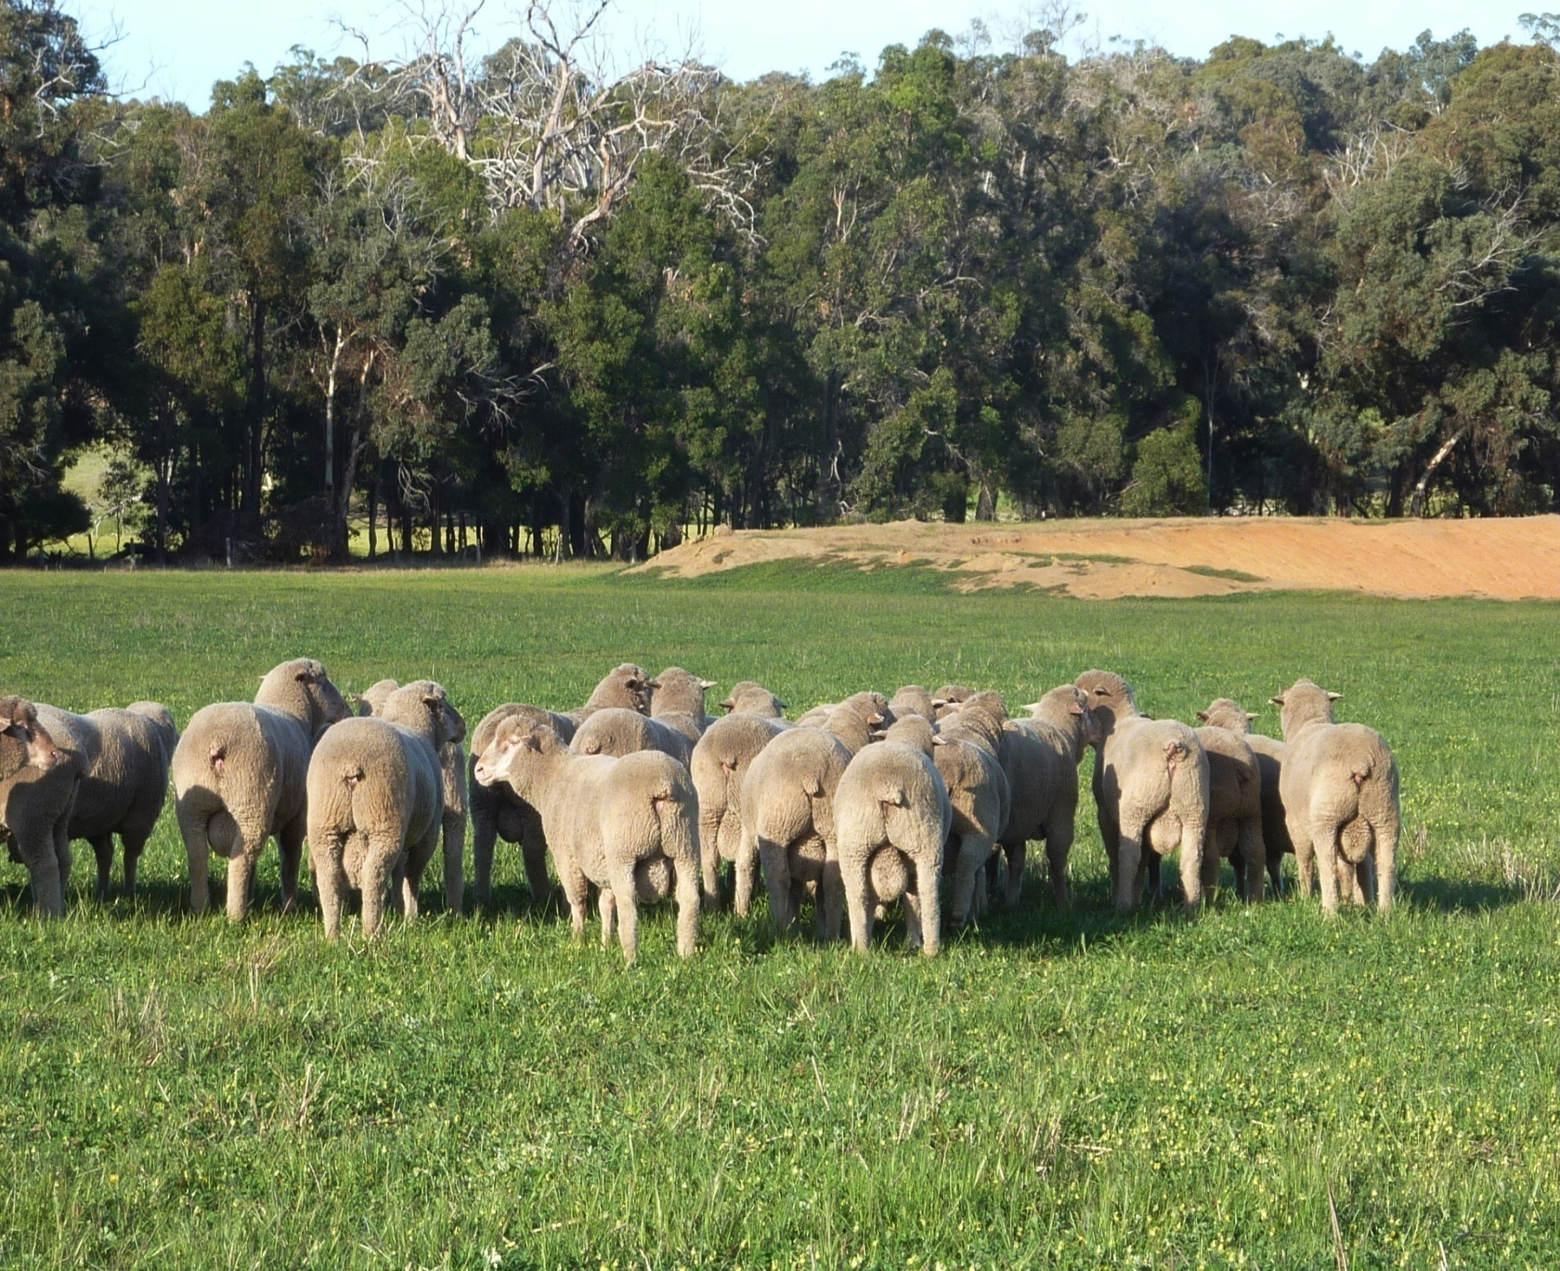
CELEBRATING 50 YEARS 1966 -2016
In the better environments in Australia the results were even more impressive than in South Africa
By using sophisticated reproduction techniques the numbers of pure Dohnes increased very rapidly
Australian woolgrowers were able to experience for themselves the improvement in profitability of the first and subsequent generations of Dohne progeny

Slide 30
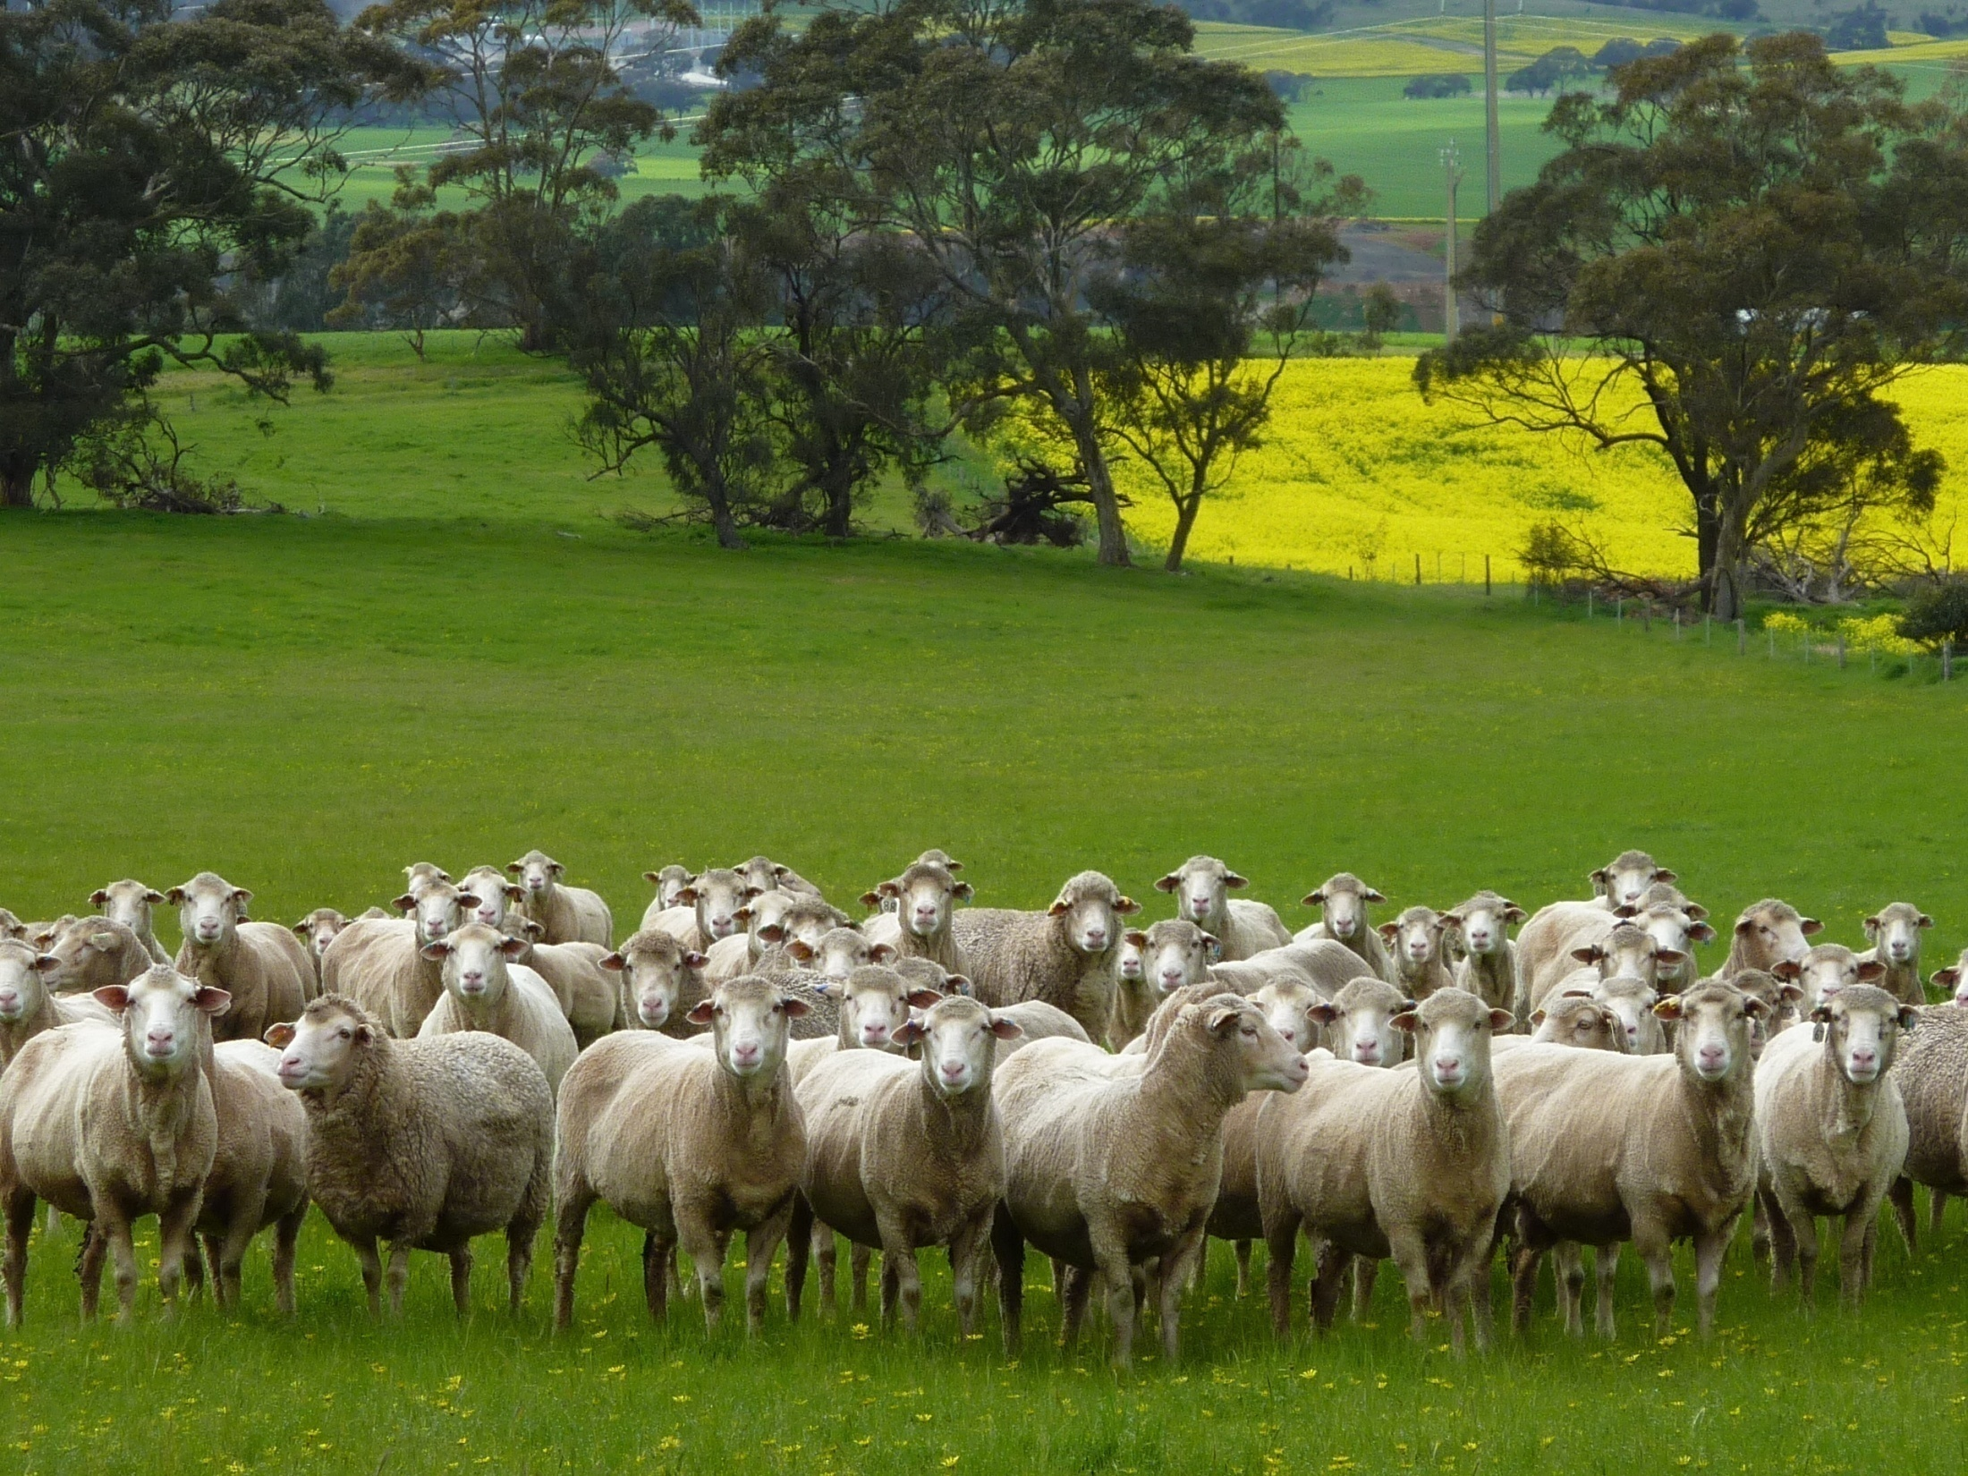
CELEBRATING 50 YEARS 1966 -2016
While fully maintaining the amount and quality of Merino wool, Australian wool growers now enjoyed the addition of prime lamb production in self replacing flocks
This was an additional lucrative income source for traditional wool growing enterprises. Even F1 (first cross) Dohne lambs easily met prime lamb export standards

Slide 31
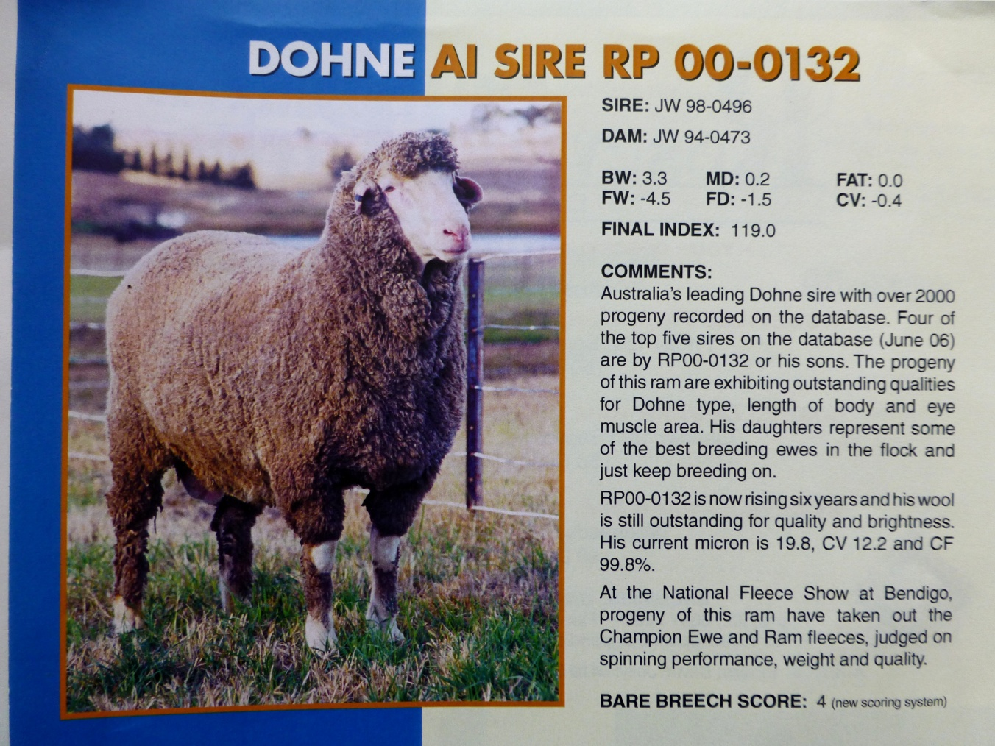

CELEBRATING 50 YEARS 1966 -2016
Many outstanding sires were identified
Sire from a pure South African embryo from the Weska Stud
No mulesing – a great plus point

Slide 32



CELEBRATING 50 YEARS 1966 -2016
Many outstanding sires were identified

Slide 33



CELEBRATING 50 YEARS 1966 -2016
GORDIE McMASTER
“Merino Visionary and Bush Legend”
Although differing substantially in our attitude to sheep breeding we have been friends since 1982
While highly critical, when seeing Dohnes for the first time in 1982, Gordie wrote this in his book: “Its beginnings were inauspicious, but in the long term it may have a major influence on Australian merino breeding” (page 112) – very prophetic!

Slide 34

CELEBRATING 50 YEARS 1966 -2016
Annual Dohne workshops
From 2002 to 2007 I visited Australia every year to conduct workshops to familiarise new and aspirant breeders with Dohne standards and principles. The welcome and kindness I received was overwhelming and I made many lasting friendships
Roseville Park 2002

Slide 35


CELEBRATING 50 YEARS 1966 -2016
Allan Casey - made Honorary Life
Member for outstanding service to ADBA
I will always be indebted to Allan Casey who was my co-presenter in most of the many workshops we held, and generally looked after my welfare in Australia.
He authored a chapter on Australian Dohne history in "Birth of a Breed“, and when visiting me in December last year, we took delivery of the book together - hot off the press from the publishers.
Allan, Lucy Leurs of
Simon Says (publishers)
and Jacobus le Roux of BKB, sponsor

Slide 36



CELEBRATING 50 YEARS 1966 -2016
They have made a great contribution to our breed
David Kain and Sally Coddington, former presidents of ADBA
Bevan Taylor, Allan Casey and
Ross Fenwick assisted at all the workshops in WA
Allan Clarke, first assessor in NSW. Allan and Bevan drove me many thousands of kilometers to workshops
Bevan even drove me across the Nullabor!!

Slide 37



CELEBRATING 50 YEARS 1966 -2016
David Kain, honorary life member of the ADBA
The Far Valley website is a most informative and educational site, illustrating the dramatic improvement in productivity since Dohnes were introduced in 2000.
I was presented with a protocopy of the book by Steve Abbot at Katanning in 2010
When I showed David the manuscript of my first book "Sheep in my Blood", David immediately adopted it as a Dohne project and wrote the foreword. It was published by the ADBA and enjoyed wide circulation.
Thank you David for your friendship and support.

Slide 38

CELEBRATING 50 YEARS 1966 -2016
South America 2002 – 2016
The Dohne can deliver a substantial reduction of Fibre Diameter in the local Corriedale and other broad-woolled breeds, while also improving reproduction and growth rate
Because lamb meat is an export commodity, it is important to consider a breed capable of weaning weight of 30kg+ and wool under 22 microns.
The Dohne Merino adequately meets these criteria. Increases of up to 60% in wool income have been reported wherever Dohnes have been used.
Photo: Juan Gysling

Slide 39



CELEBRATING 50 YEARS 1966 -2016
URUGUAY
Uruguay (Cabaña Tres Arboles) introduced the Dohne
in 2002, and it is now well established. At least three studs and their satellite flocks supply rams in increasing numbers to commercial sheep breeders.
My friend Roberto Cardellino has been a major role player in the introduction of Dohnes to South America. He is with Daniel and Nicolás Rubio of the Tres Arboles Stud

Slide 40




Roberto and me – good friends since 1980.
CELEBRATING 50 YEARS 1966 -2016
URUGUAY
Gabriel Capurro, President of
Uruguay Dohne Association,
and his son
US$700
Tres Arboles dispersal sale, March 2016
Dohnes have realised the highest average
ram prices of all sheep breeds this year

Slide 41



CELEBRATING 50 YEARS 1966 -2016
Argentina
Dohne sires, Rio Mayo
Alejandro Vozzi
Dohne exhibition organized by Sociedad Rural de Río Gallegos. Feb 2016

Slide 42



The breeding programme of the Dohne Merino in Argentina
Modern breeding programme where 100% of animals registered in the Herdbook have productive and genealogical information
Features Breeding Programme
Distribución de las cabañas, planteles fundacionales y uso en majadas generales
Distribution studs (pure bred and commercial flocks)
Implemented by the Argentina Association Merino Breeders.
PRO-OVINO AVANZADO as a selection tool: All animals have genetic information (EPDs) for wool and meat characteristics.
All animals are classified and authorized by Argentina Merino Breeders Association Inspector.
Open nucleus.
Figure 1: Diagram of genetic improvement programme Dohne Merino breed in Argentina
Cabañas PDP
Dohne Merino numbers
450 ewes (pure) in mating (2016)
2.000 ewes in upgrading (on Merino)
8 studs
1.500 animals with genetic evaluation
9 traits (wool, meat and feed intake)
2 selection index
95 sires with genetic evaluation
Alejandro Vozzi
Majadas generales

Slide 43




CELEBRATING 50 YEARS 1966 -2016
Chile
Since 2009 the value of wool on this property has increased by 65% for hogget wool and by 60% for adult wool with Dohne blood
Hugo Vera and Daniel Groves
Rams from Mt Alma embryos
Corriedale x Dohne hoggetts,
Santa Barbara, Tierra del Fuego

Slide 44



CELEBRATING 50 YEARS 1966 -2016
Chile
Los Condores:
7000 ha - carries 5000 sheep
Has reduced micron from 29µ to 24µ
in a few years with Dohne infusion
Scans 111% and weans 90% on tussock with no supplements
Has Increased 6 months body weight of lambs from 30 to 40kg
Hernan Elizalde with his team who inseminate 8000+ ewes p.a. with Dohne semen

Slide 45


CELEBRATING 50 YEARS 1966 -2016
Peru
Dr William Vivanco Dohne breeding projects in the high Andes – Alt. 3000-4000m

Slide 46


Classification of the potential of the different breeds of sheep for fine wool and heavy lamb production
Meat
Weaning weight (kg)
Dual purpose
Meat producers
Dual purpose
Milk producer
25
Dual purpose
Wool
Milk
23
Wool (µ)
Design: Alfonso Bouroncle and William Vivanco

Slide 47



CELEBRATING 50 YEARS 1966 -2016
Falkland Islands
Ben Bertsen
with ET and AI Dohne rams
From 2003 Dohnes were imported from both Australia and South Africa. Outstanding results have been achieved with an increase in production and revenue from finer wool and meat.

Slide 48












CELEBRATING 50 YEARS 1966 -2016
Logos

Slide 49

CELEBRATING 50 YEARS 1966 -2016
Jilly - she was my best friend and a brilliant worker

Slide 50


CELEBRATING 50 YEARS 1966 -2016
Birth of a Breed – my legacy
Please adopt the last chapter – The Epilogue - as your
blueprint for the future. It charts the way forward.
It is up to us as Dohne breeders, to continue to improve and enhance the attributes of our sheep by adhering to the fundamental principles that have led to success.
In the 50 years of its existence, the Dohne Merino Breed Society of South Africa has made a major contribution to sheep production not only at home, but in every country where Dohnes are run. I predict a brilliant future for our breed which will continue to improve and expand.
Liza Mari Swart contributed many pictures, including the covers

Slide 51

CELEBRATING 50 YEARS 1966 -2016
Thank You

Slide 52
CELEBRATING 50 YEARS 1966 -2016

